Slide 1
From Statistical Models to Neural Representations

Slide 2
Statistical Model of a Language
Vocabulary (V)
Word w ∈ V
Language (L)
Sentence s ∈ L
L ⊂ V* usually infinite
s = w₁ ,…w_{N}
Probability of s =P(s)
Find P(S = W_{1,n}= <w_{1,n}>) where w_{1,n} is a sequence of words

Slide 3
Probability of a sequence
Compute probability of sequences - P(w₁ ,w₂ ,..,w_{n} )
Decompose using the chain rule of probability
P(w₁ ,w₂ ,..,w_{n} ) =P(w₁ )P(w₂ |w1 )P(w₃ |w₁ ,w₂),… P(w_{n} |w₁ ..,w_{n-1})
Markov assumption : we can predict the probability of some future unit without looking too far into the past

Slide 4
Predicting words to complete sequences
Given a sequence w₁w₂w₃…w_{n-1} – predicting next word w
Predicted word w = Maximum_Likelihood_EstimateP(w|w₁w₂w₃…w_{n-1})

Slide 5
If you wanted your computer to write your story
The student ………………..

Slide 6
DIFFICULTIES FACED
Statistical language modeling attempted to learn the joint probability function of sequences of words in a language
Without large volumes of data - it would not be feasible to expect exactly similar sequences of n-grams
The model suffers from Curse of dimensionality
Cannot handle language disambiguation
Synonyms, homonyms, Sense

Slide 7
WORD EMBEDDINGS
NEURAL LANGUAGE MODELS

Slide 8
DISTRIBUTED REPRESENTATION OF WORDS – GENERAL IDEA
Associate with each word in the vocabulary a distributed word feature vector - a real-valued vector in R^{m}
Express the joint probability function of word sequences in terms of the feature vectors of these words in the sequence
Learn simultaneously the word feature vectors and the parameters of that probability function
m is dimension of vector space – much smaller than size of vocabulary

Slide 9
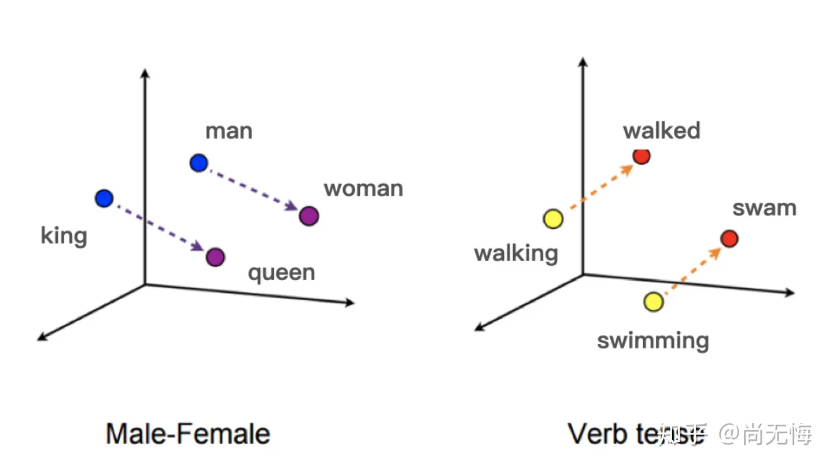

Slide 10
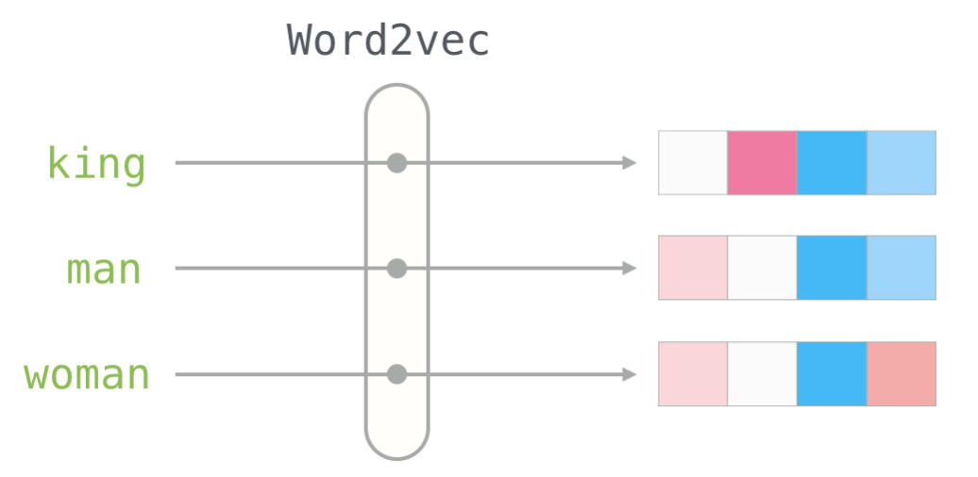
Word2Vec – If words could be vectors!
It would be possible to compute Euclidean distances between words as a measure of similarity
King : queen :: man : ? - woman
https://jalammar.github.io/illustrated-word2vec/

Slide 11
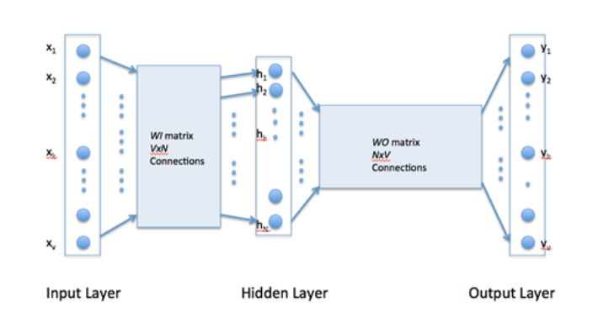
Autoencoder Architecture for learning Word Vectors
The second matrix encodes the representation of words

Slide 12
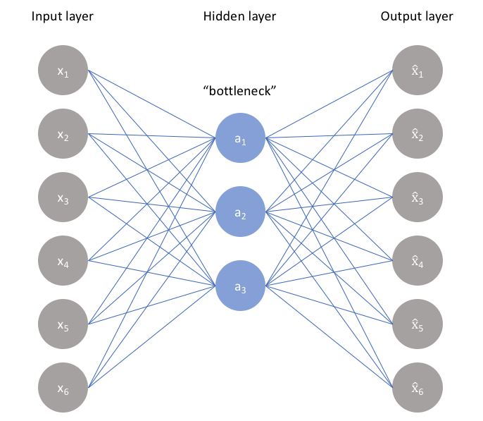

The ideal autoencoder model balances the following:
Sensitive to the inputs enough to accurately build a reconstruction
Insensitive enough to the inputs that the model doesn't simply memorize or overfit the training data

Slide 13
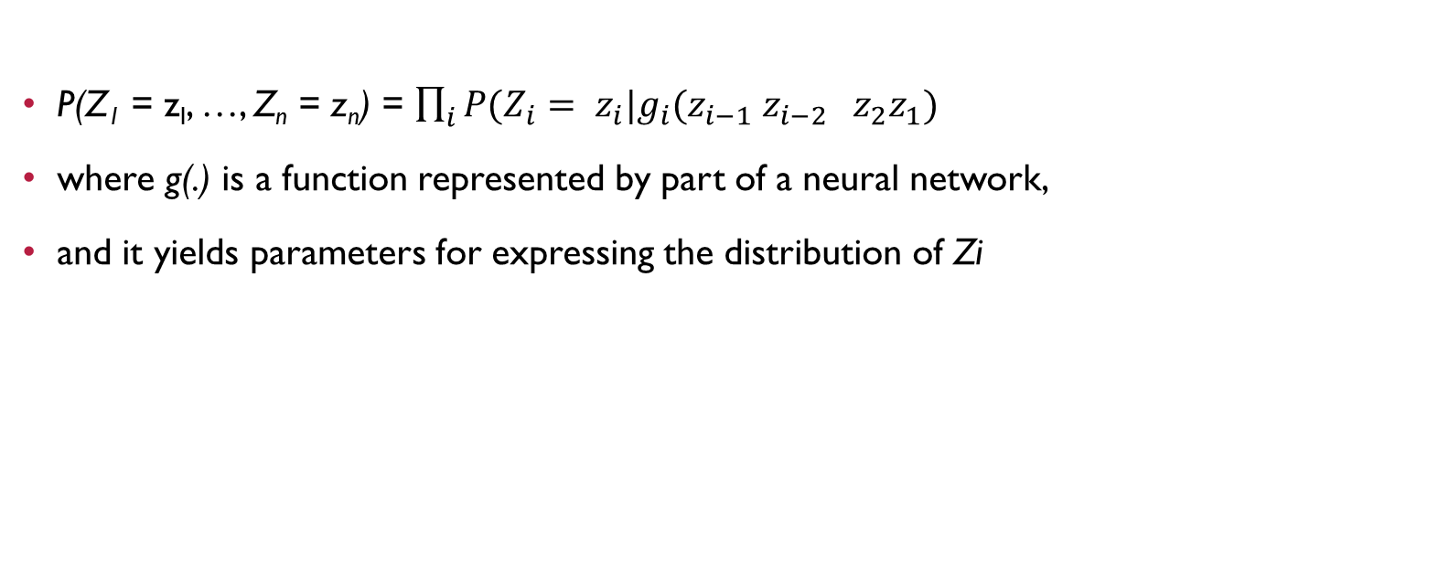
THE MATHEMATICS BEHIND IT

Slide 14
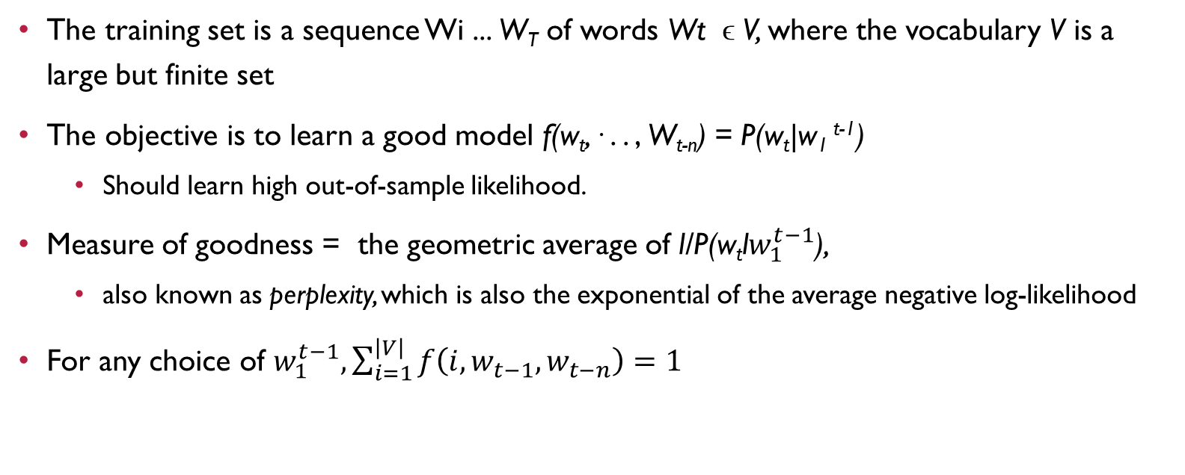
TRAINING THE WORD VECTORS

Slide 15
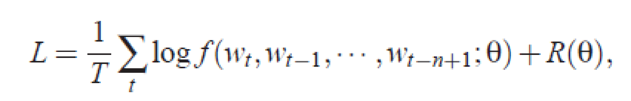

BUILDING THE NEURAL MODEL
Training looks for the ϴ that maximizes the training corpus penalized log-likelihood

Slide 16
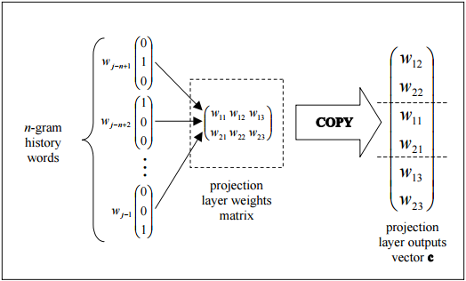
PROJECTION LAYER
The projection layer is shared such that for contexts containing the same word multiple times, the same set of weights is applied to form each part of the projection vector
This organization effectively increases the amount of data available for training the projection layer weights since each word of each context training pattern individually contributes changes to the weight values.

Slide 17
LIMITATIONS OF THE ABOVE MODEL
Number of output units = |V|
For every training sequence – the total number of weights to be learnt
Q = N * D + N * D * H + H * V
N – the context length is to be fixed before
H * V is the dominating factor – hence the size of vocabulary was restricted

Slide 18
NEW LOG LINEAR MODELS
Minimize computational complexity
Most of the complexity is caused by the non-linear hidden layer in the model
Objective was to explore simpler models that might not be able to represent the data as precisely as neural networks, but can possibly be trained on much more data efficiently
For measuring the quality of the resulting vector representations, it was checked whether similar words tend to be close to each other
Words can have multiple degrees of similarity
Computer, Computing, Computation
King, queen, palace, royalty

Slide 19
SKIP-GRAM MODEL
Feedforward Neural Network with the projection layer shared for all words - all words get projected into the same position (their vectors are averaged)
A bag-of-words model as the order of words in the history does not influence the projection.
Also use words from the future
Log-linear classifier with four future and four history words at the input
Training criterion - Correctly classify the current (middle) word

Slide 20
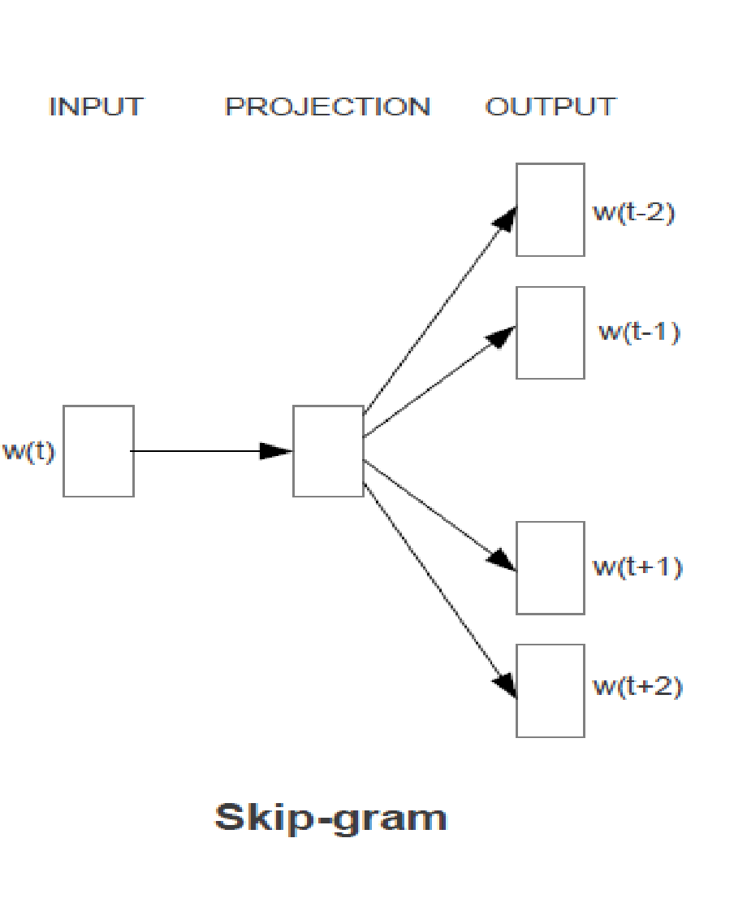
SKIP-GRAM MODEL
Train a simple neural network with a single hidden layer to perform a certain task
However - that neural network is not going to be used
Goal is actually just to learn the weights of the hidden layer
These weights will represent the “word vectors”

Slide 21
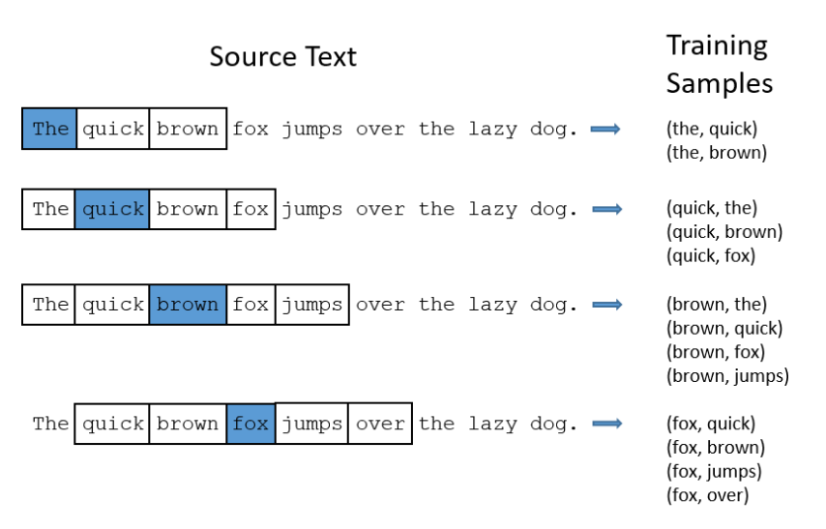
THE FAKE TASK
Train a neural network to do the following
Given a specific word in the middle of a sentence (the input word) – if we pick one nearby word at random - the network will tell us the probability for every word in our vocabulary of being the “nearby word” that we chose
Nearby – size of window

Slide 22
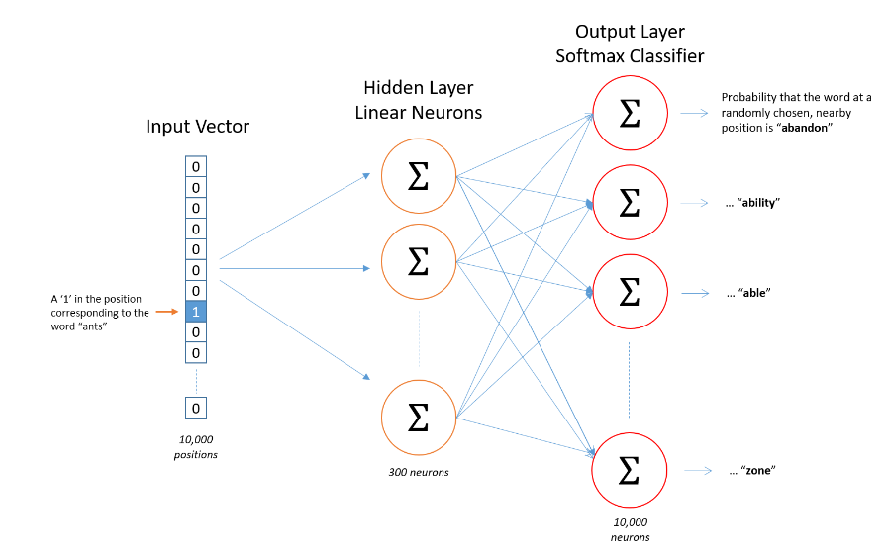
The Hidden Layer
Suppose we’re learning word vectors with 300 features – then the hidden layer is going to be represented by a weight matrix with 10,000 rows and 300 columns

Slide 23
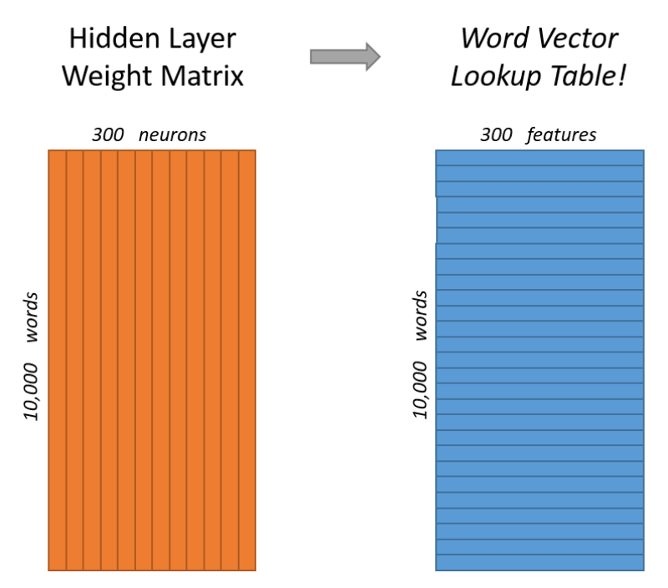
The Output Layer
The 1 x 300 word vector for an input word gets fed to the output layer – which is a softmax regression classifier
Each output neuron will produce an output between 0 and 1, and the sum of all these output values will add up to 1
Specifically, each output neuron has a weight vector which it multiplies against the word vector from the hidden layer
It then applies the function exp(x) to the result and divides this by the sum of the results from all 10,000 output nodes

Slide 24
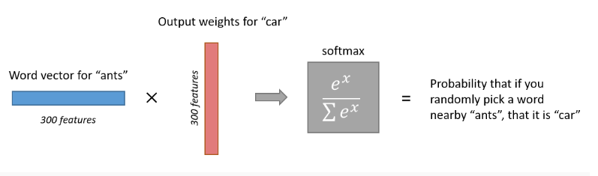
PROBABILITY OF A RANDOM “NEARBY” WORD

Slide 25
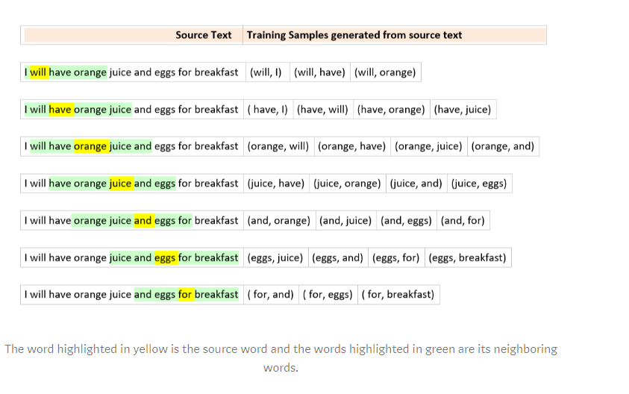
TRAINING SKIP-GRAM MODELS
We will complete the forward pass for all 4 target words ( have, orange, and, eggs).
Calculate the errors vectors[1xV dimension] corresponding to each target word. – so 4 1xV error vectors
Perform an element-wise sum to get a 1xV vector
The weights of the hidden layer will be updated based on this cumulative 1xV error vector.
The back propagation for training samples corresponding to a source word is done in one back pass
If the target word is juice and window size is 2
its neighboring words will be ( have, orange, and, eggs)
Input and target word pairs will contain (juice, have), (juice, orange), (juice, and), (juice, eggs)

Slide 26
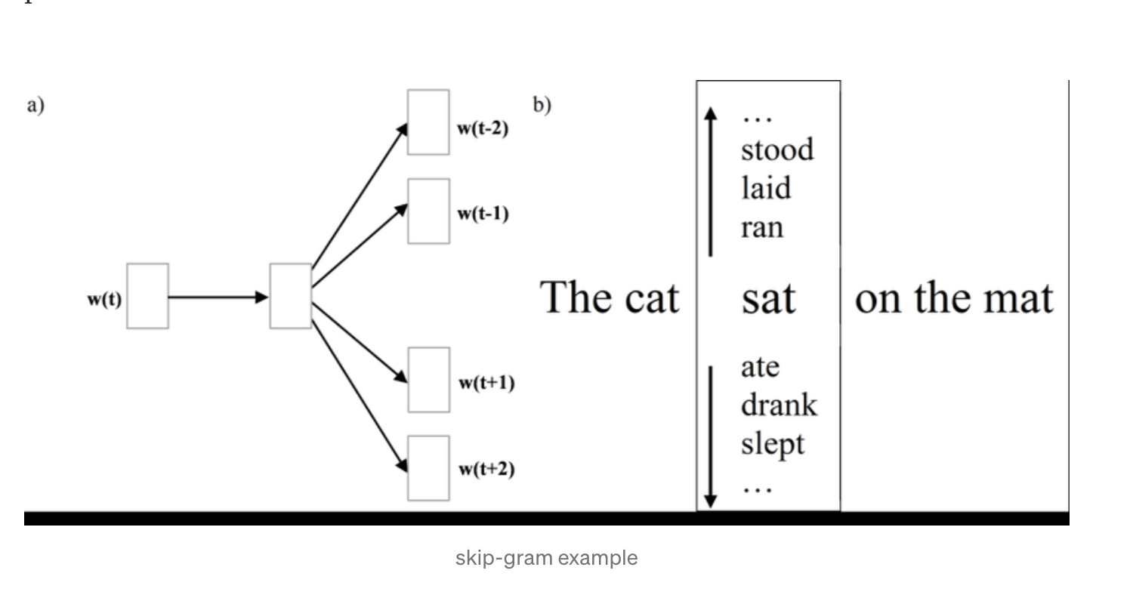
Skip gram Prediction

Slide 27
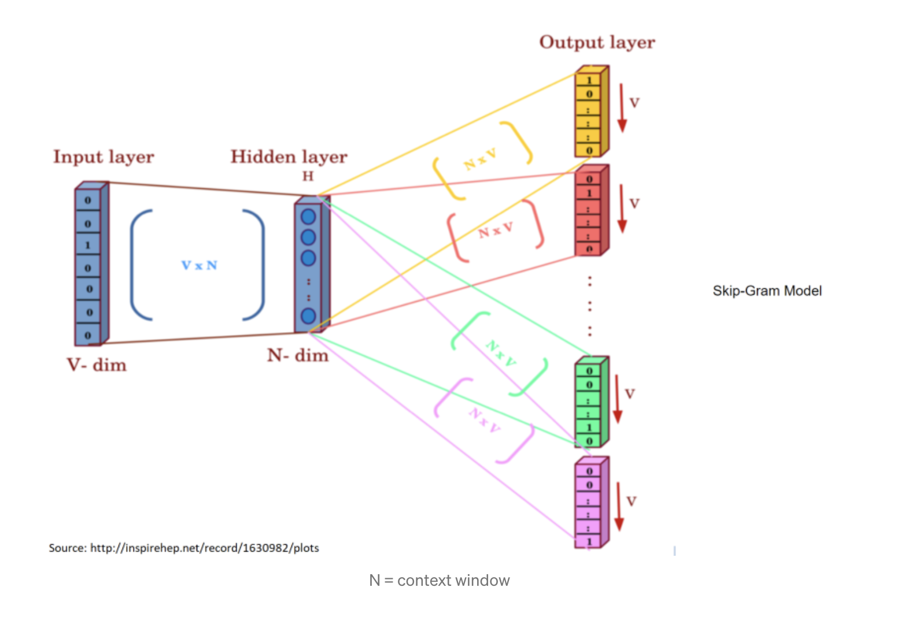

Slide 28
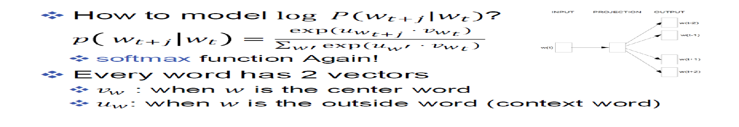
RECAPITULATION
I love cats and dogs but not birds as pets
V = cats
P = I
P = love
P = and
P = dogs
U vectors
Vector for a | Vector for and | Vector for cats |  | Vector for dogs |  | Vector for i |  |  | Vector for Zebra
Vector for a | Vector for and | Vector for cats |  | Vector for dogs |  | Vector for i |  |  | Vector for Zebra
V vectors

Slide 29
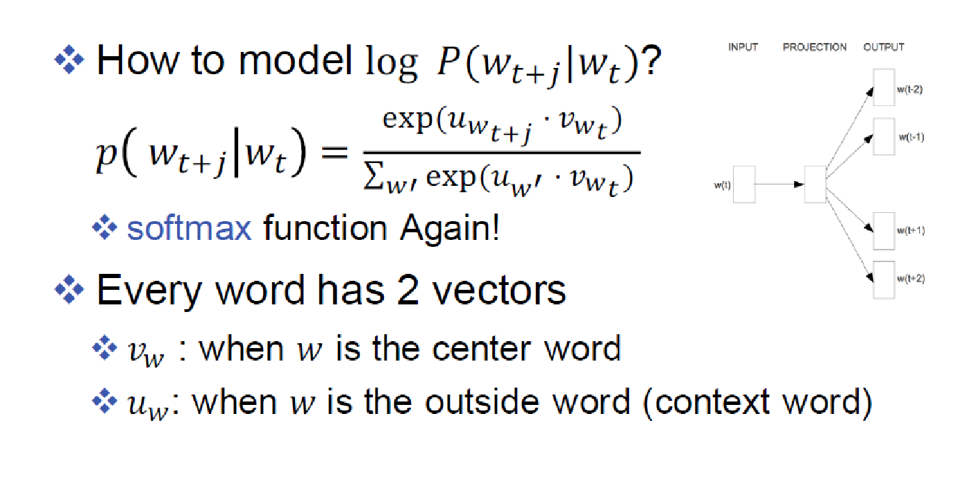

Slide 30
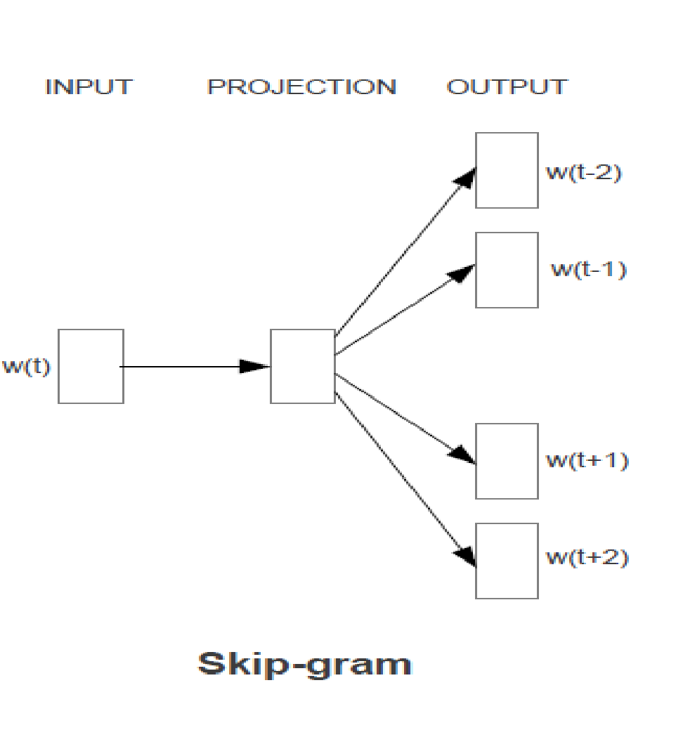
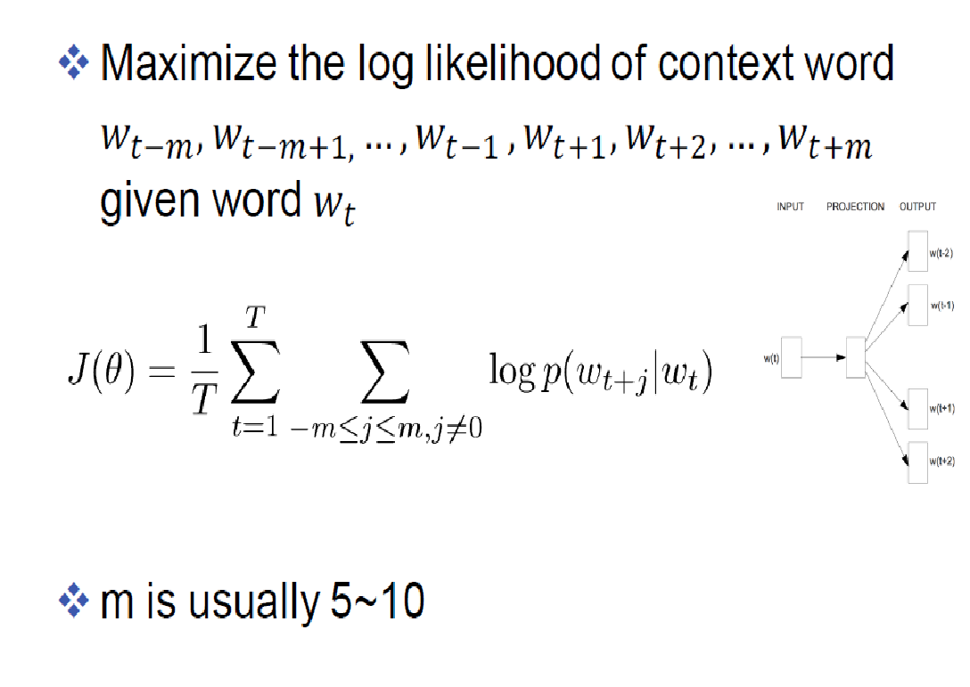
Joint prediction of all surrounding words

Slide 31
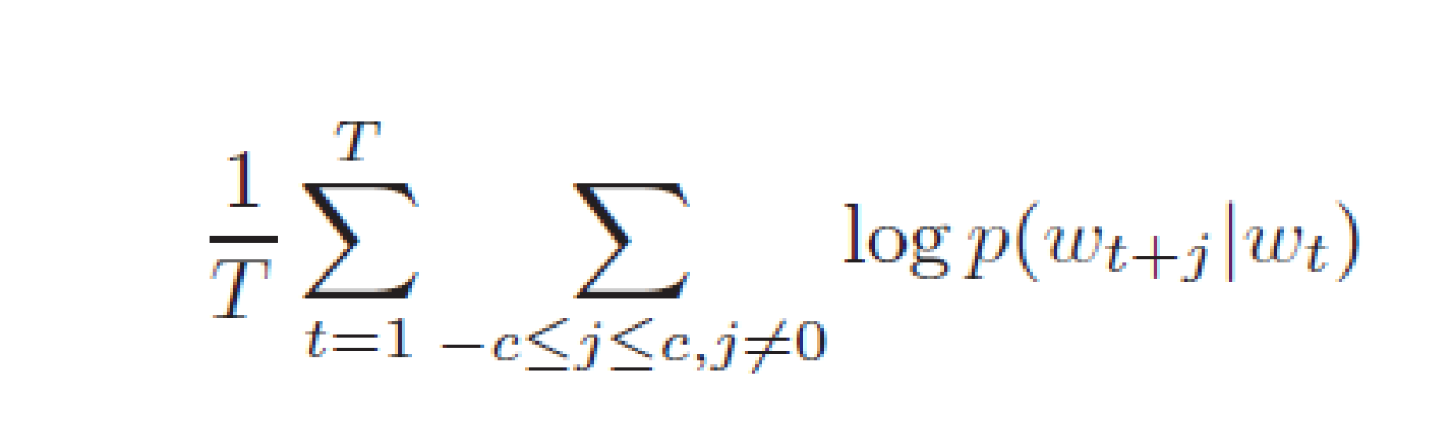
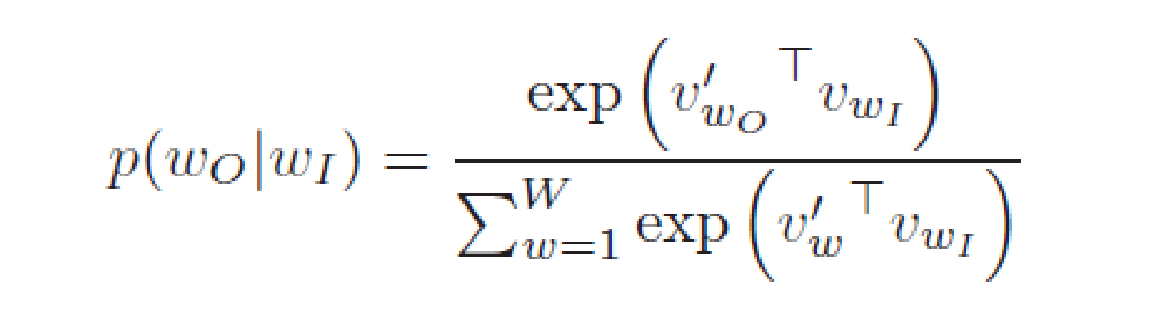
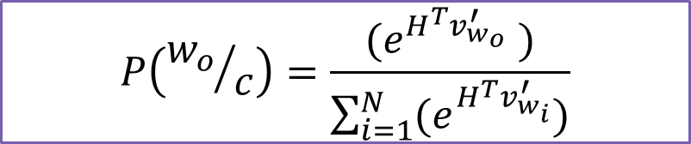
SOFTMAX COMPUTATION FOR SKIP-GRAM
Given a sequence of training words w₁, w₂, …, w_{T} - Maximize average Log Probability
Large values of context c – will yield more training samples – more computing time
Having |V| output nodes is not practical

Slide 32
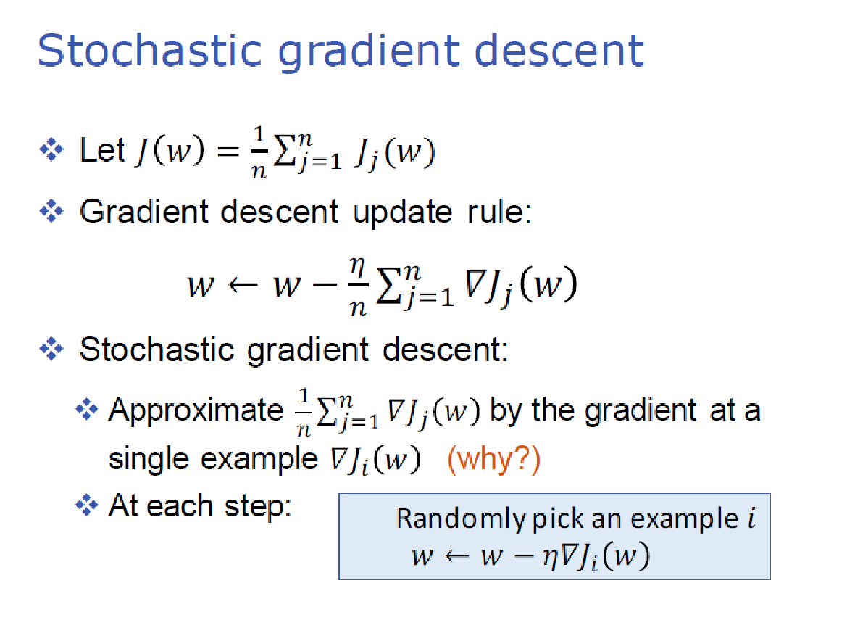
https://towardsdatascience.com/skip-gram-nlp-context-words-prediction-algorithm-5bbf34f84e0c

Slide 33
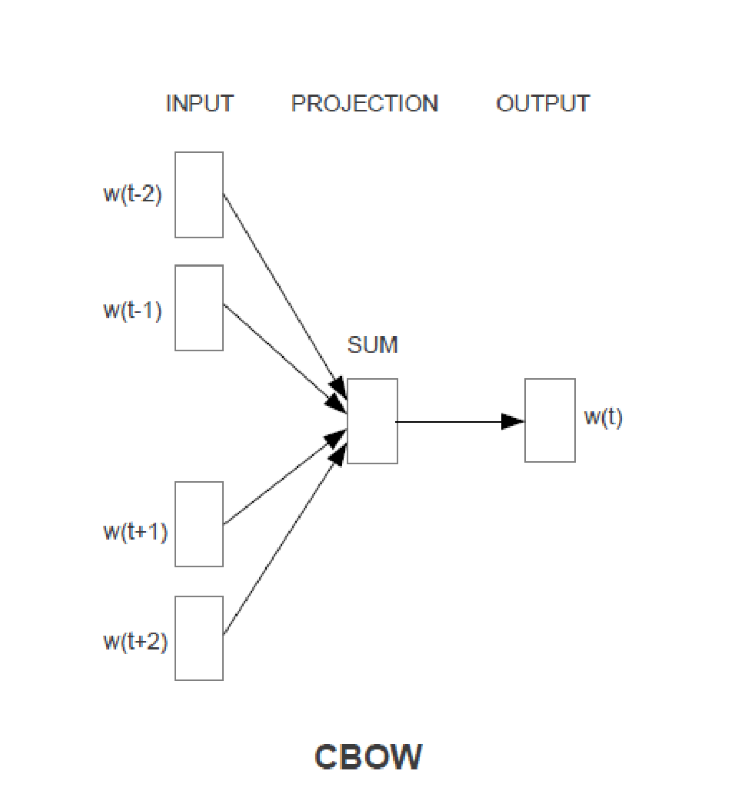
CONTINUOUS BAG OF WORDS MODEL
The fake task in CBOW is somewhat similar to Skip-gram
Take a pair of words and teach the model that they co-occur but instead of adding the errors we add the input words for the same target word
If we have 4 context words for a single target word, we will have 4 1xV input vectors.
Each will be multiplied with the VxE hidden layer returning 1xE vectors.
All 4 1xE vectors will be averaged element-wise to obtain the final activation which then will be fed into the softmax layer

Slide 34
COMPARISON
Skip-gram: works well with a small amount of the training data, represents well even rare words or phrases
CBOW: several times faster to train than the skip-gram, slightly better accuracy for the frequent words.
Step by Step understanding of weight learning
https://thinkinfi.com/continuous-bag-of-words-cbow-single-word-model-how-it-works/

Slide 35
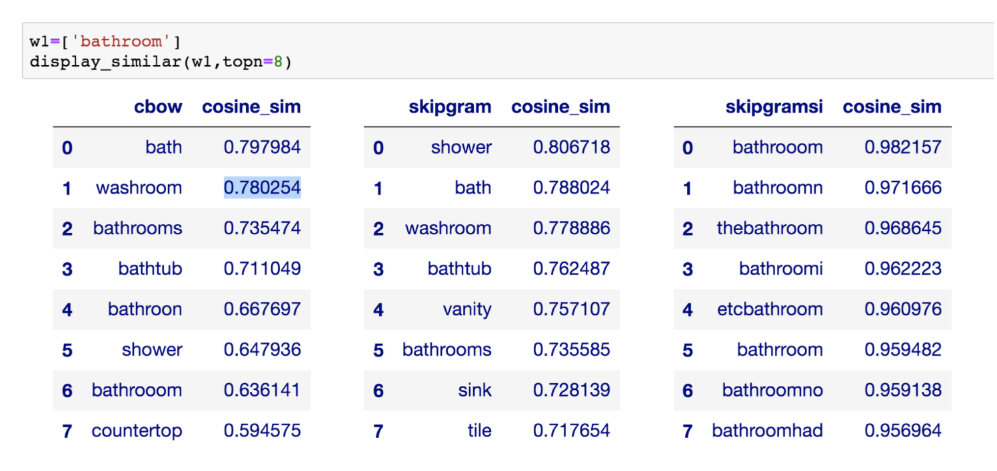

Slide 36
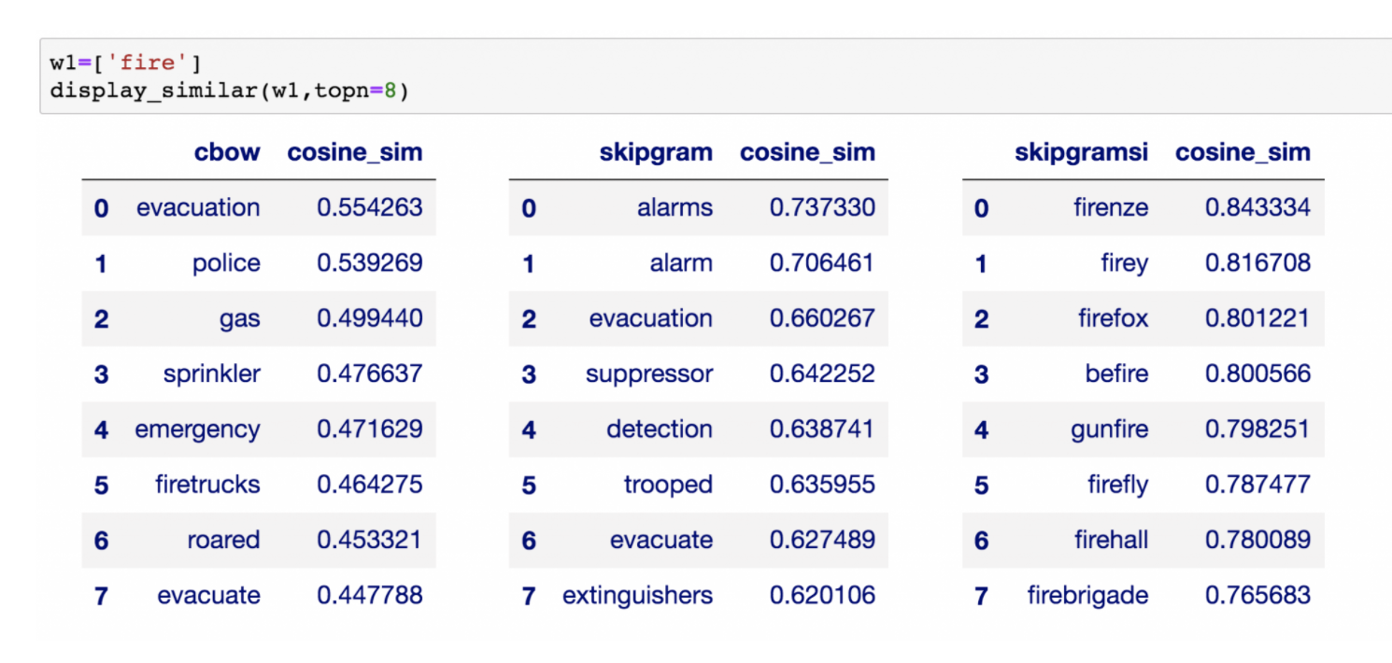

Slide 37
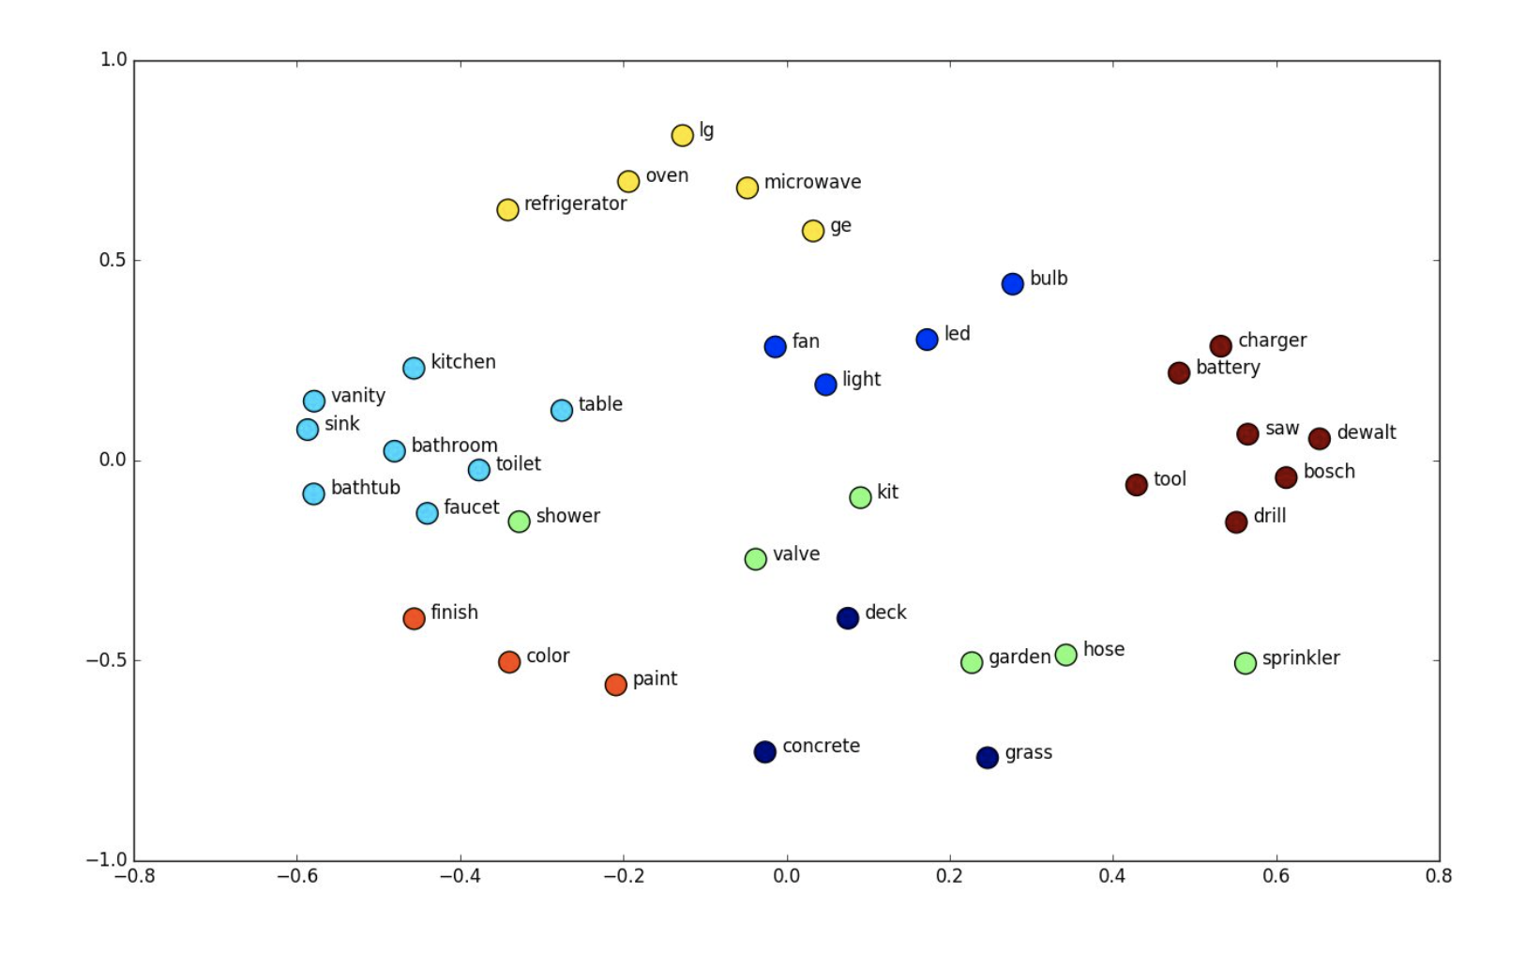
Distribution of words in N (50/300/500) dimensional space - visualization
2 D plot - using PCA -
https://cs.stanford.edu/people/karpathy/tsnejs/csvdemo.html

Slide 38
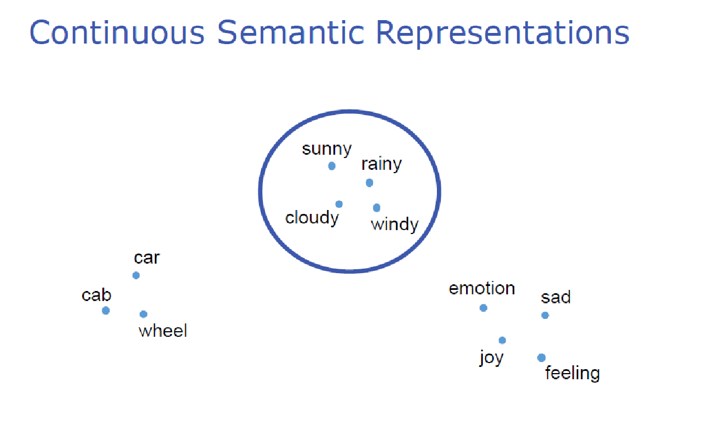
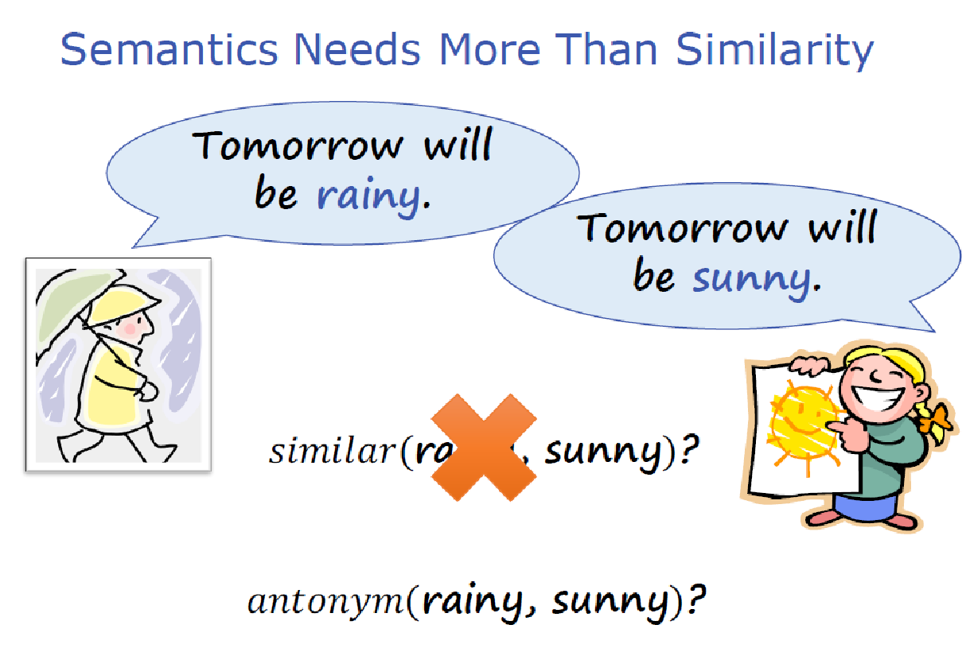
Application dependent training for maximum benefit

Slide 39
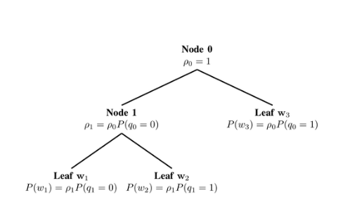
HIERARCHICAL SOFTMAX
All words are at leaf nodes
The path is a sequence of words (context) that lead to that word
P(w/context) = path cost of reaching that word taking the context as a path
At each node – we need the Probability of branching right or left
A Binary Tree at the Output Layer

Slide 40
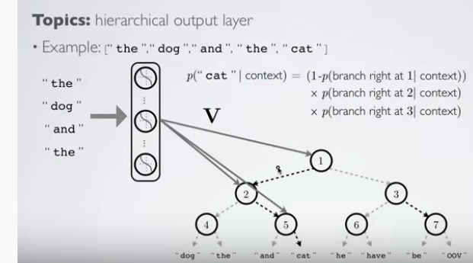
Each internal node in the tree is a sigmoidal output in the NN – but the number of probability computation would be less
P(“cat”/”The””dog””And””The”) =
P(branch left at 1|context)
X P(branch right at 2/context)
X P(branch right at 5/context)
P(“cat”/”The””dog””And””The”) =
1 - P(branch right at 1|context)
X P(branch right at 2/context)
X P(branch right at 5/context)

Slide 41
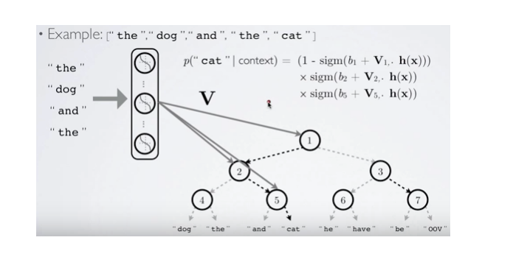
EXAMPLE
V1
V2
V5

Slide 42
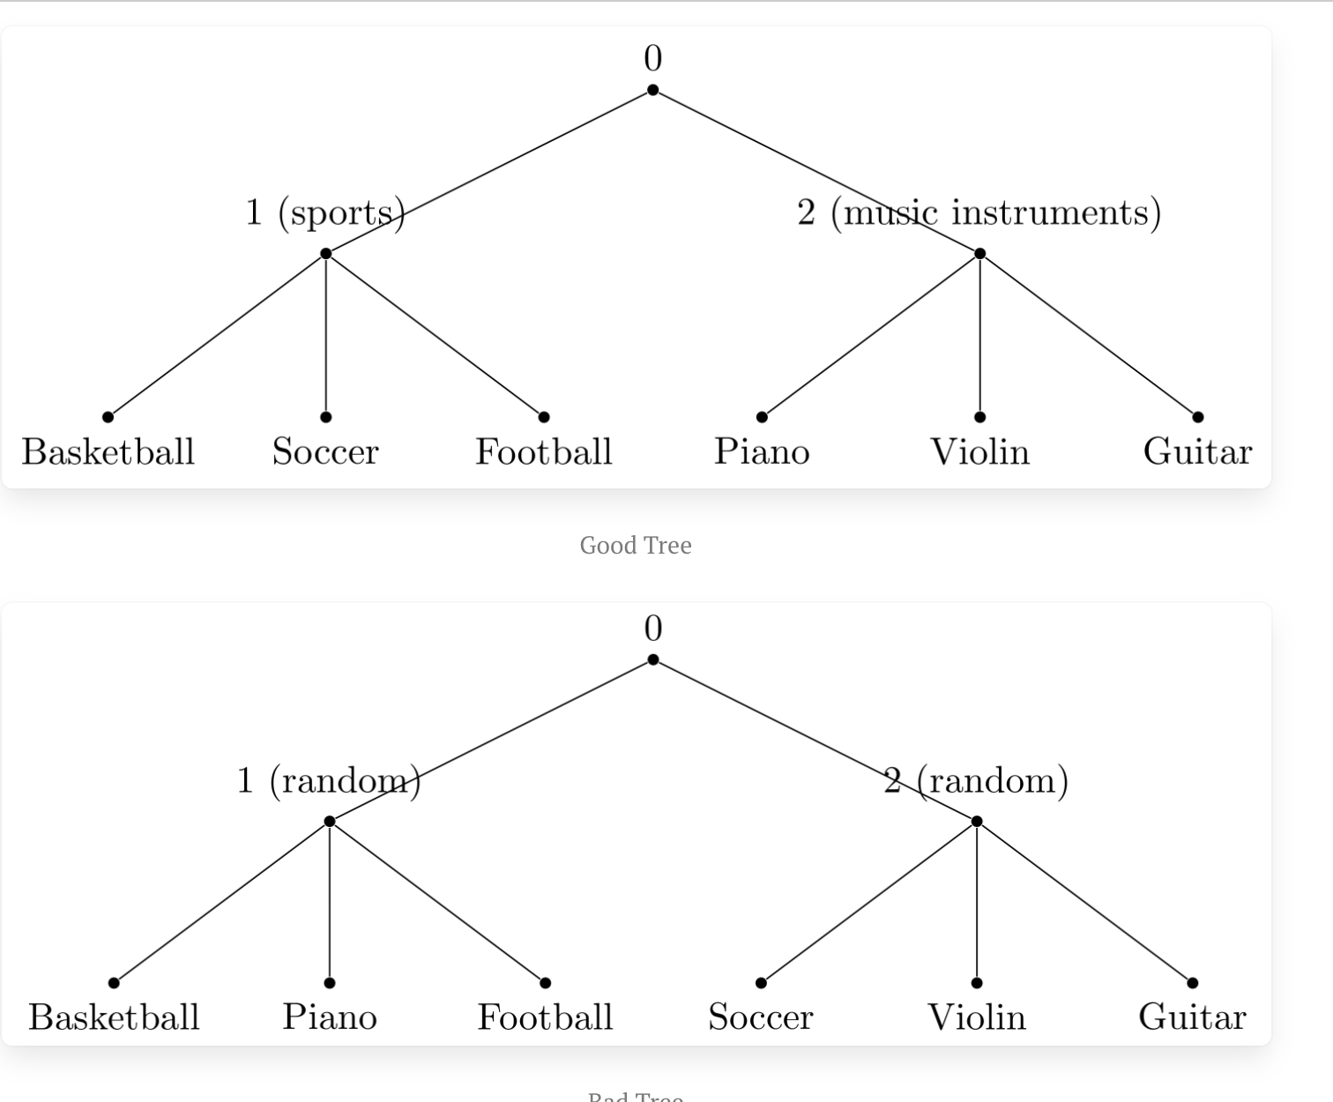
HOW TO GENERATE THE TREE?
Can generate a randomly generated tree
Performance will not be good
Can use WordNet
Using most Frequent Sense – one representation per word

Slide 43
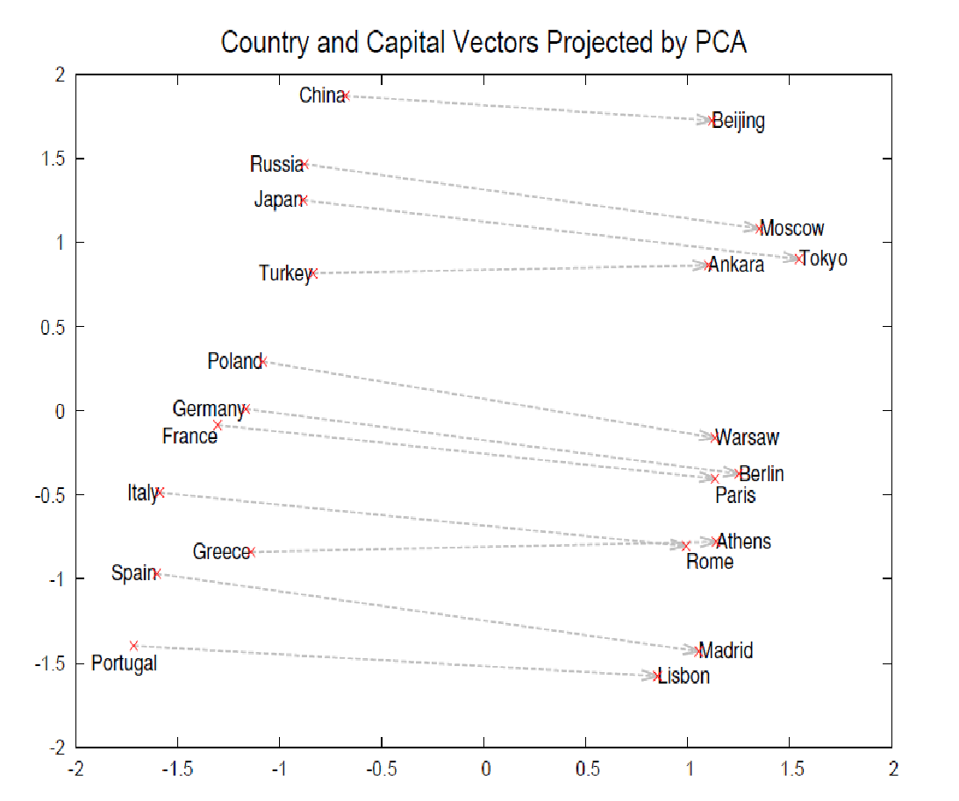
VECTOR ALGEBRA ON WORDS

Slide 44
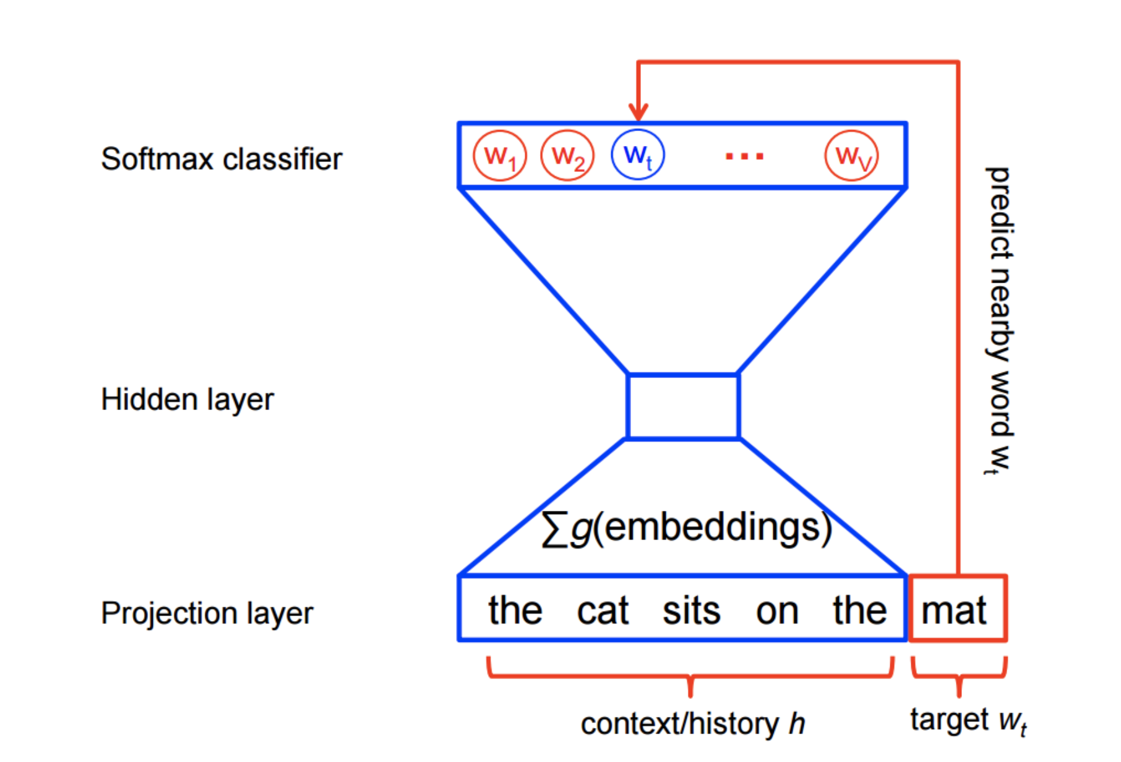
Today is a very ... day
Which model?
It …. …. delightful …. ….
Which model?
Which one is most likely? Why?
It was a delightful day yesterday
It was a delightful lunch yesterday
It was a delightful program yesterday

Slide 45
OTHER WAYS TO REDUCE COMPUTATIONAL COMPLEXITY - NEGATIVE SAMPLING
Subsampling frequent words to decrease the number of training examples.
Negative Sampling - Modifying the optimization objective – such that each training sample updates only a small percentage of the model’s weights
Subsampling frequent words and applying Negative Sampling not only reduces the compute burden of the training process, but also improves the quality of the resulting word vectors

Slide 46
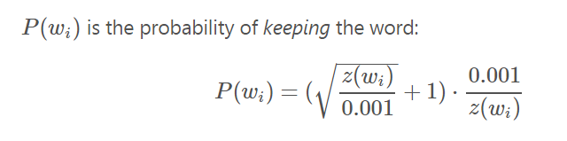
SUBSAMPLING - 1
Sampling rate determines Probability with which to keep a given word in the vocabulary
Sampling parameter – 0.001 (say)
For w_{i} – let z(w_{i}) – denote its relative frequency in the corpus
If word “house” occurs 1000 times in a corpus of 1 billion words – what is the probability that it will be retained for training?
What should be the frequency of a word to ensure that it has 50% chance of being retained in training?

Slide 47
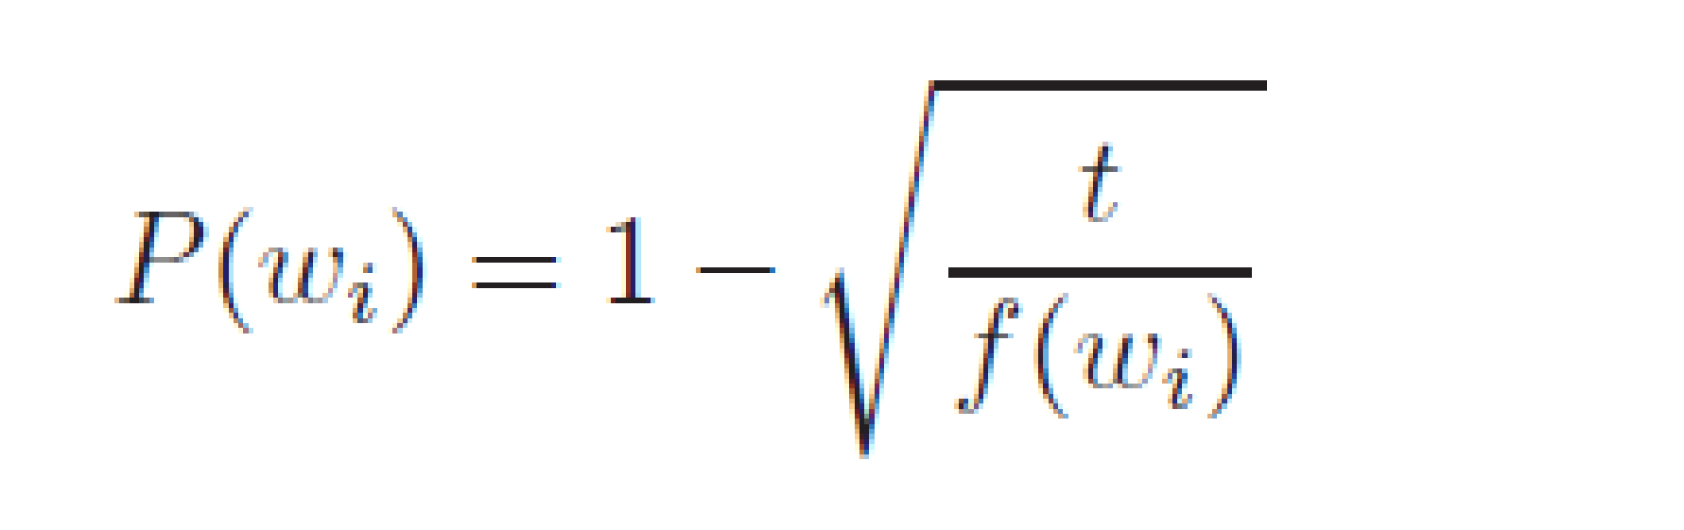
SUBSAMPLING - 2
Probability of discarding a word for training epochs
Higher the frequency – lesser number of times it will be picked up for training
Vector representation of frequent words do not change much
t = 10⁻⁵ ⁻ typical value of threshold

Slide 48
NEGATIVE SAMPLING
To train a Neural Network for a corpus of 10⁶ words, where each word is represented by 300 dimensional vector – 300*10^6 weights have to be updated for each training
Negative sampling
During each training sample only a small percentage of these weights are modified
Example - While training the network on the word pair (“fox”, “quick”) – if desired output is quick
Output neuron corresponding to “quick” should be 1
All other neurons should output a 0
Negative sampling suggests – rather than correcting all weights – update the weights for a small number of “negative words” to output 0 and the weight for the “positive” word (i.e. “quick”)
Small – Typically 5 to 20

Slide 49
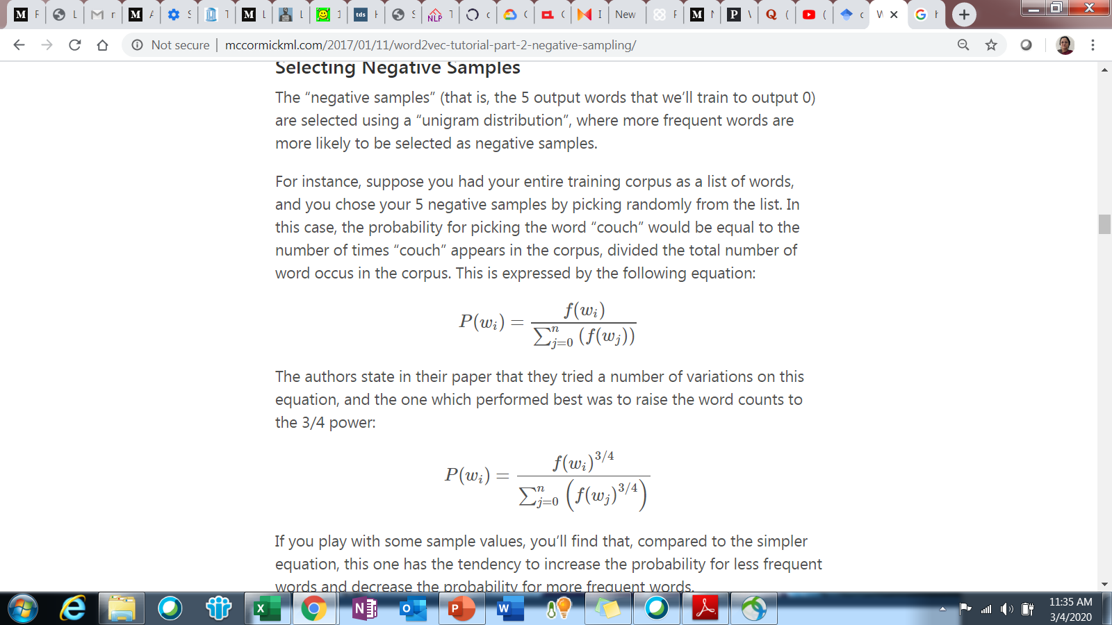
SELECTING NEGATIVE SAMPLES
Negative samples are selected using a “unigram distribution”
More frequent words are more likely to be selected as negative samples
From earlier example – Probability of “house” getting selected for weight adjustment is proportional to its frequency
 | Old formula | New formula
The | 0.4 | 0.35922
Dog | 0.166667 | 0.213593
How does it affect?
“The dog and the cat” - corpus

Slide 50
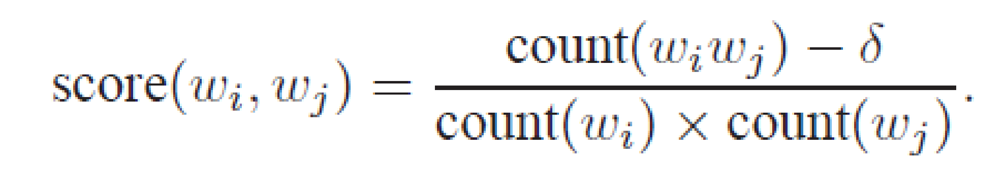
LEARNING PHRASE REPRESENTATION
A pair of words wi and wj constitutes a phrase if the score is positive
Run 2 to 4 times with decreasing threshold to get longer phrases
New York
Boston Herald
New York City
New York Times
These phrases are then treated as a linked word – and their vectors learnt

Slide 51
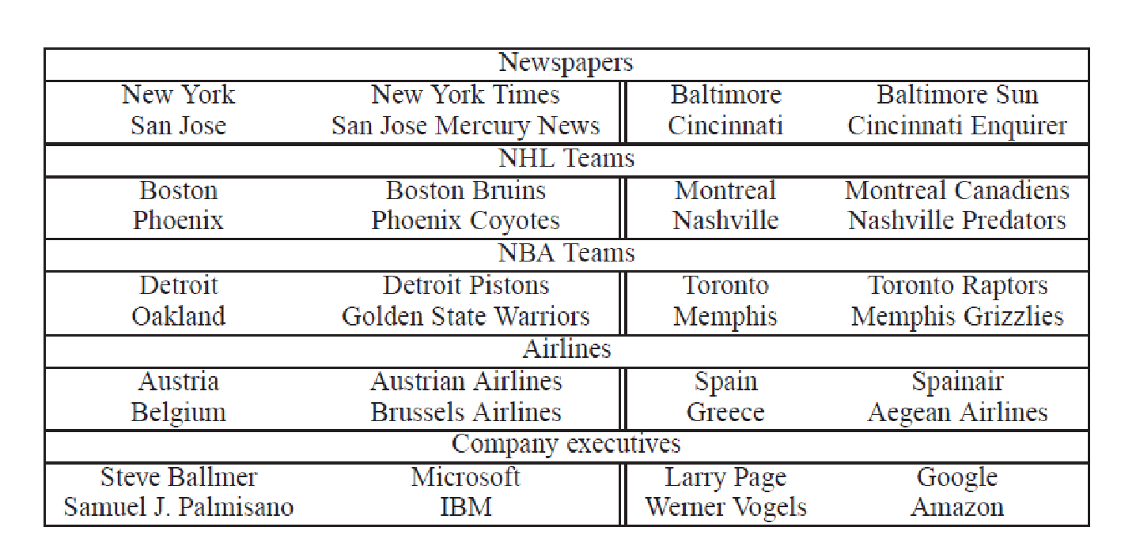
ANALOGICAL REASONING - TESTING FOR GOODNESS OF WORD VECTORS
Given the first three phrases – predict the fourth phrase

Slide 52
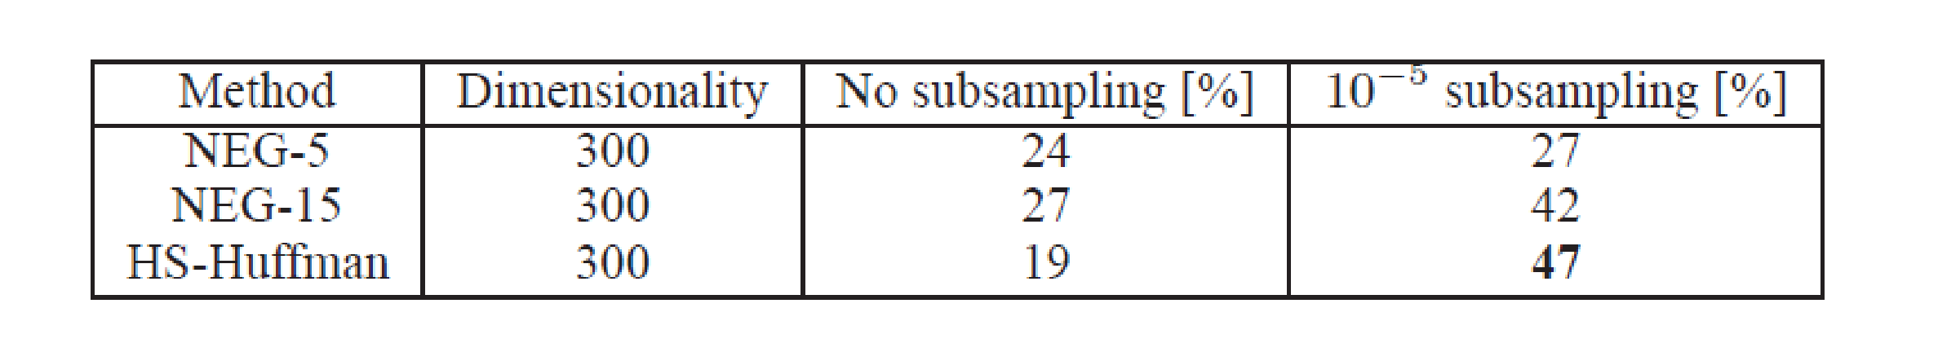
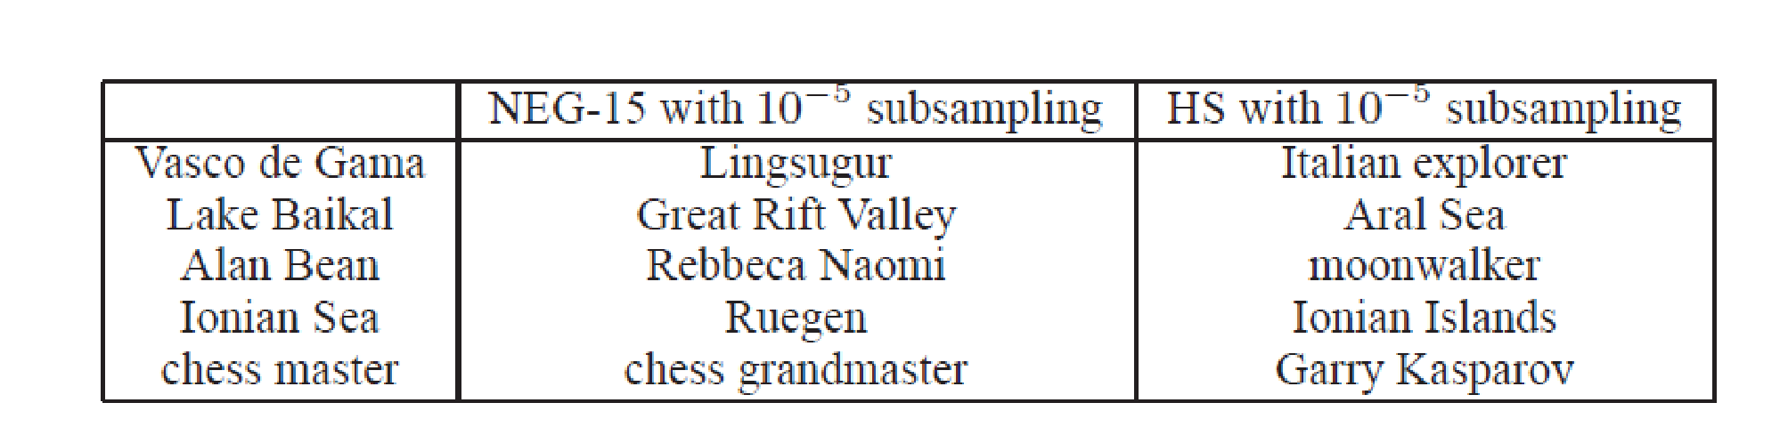
COMPARATIVE RESULTS [3]

Slide 53
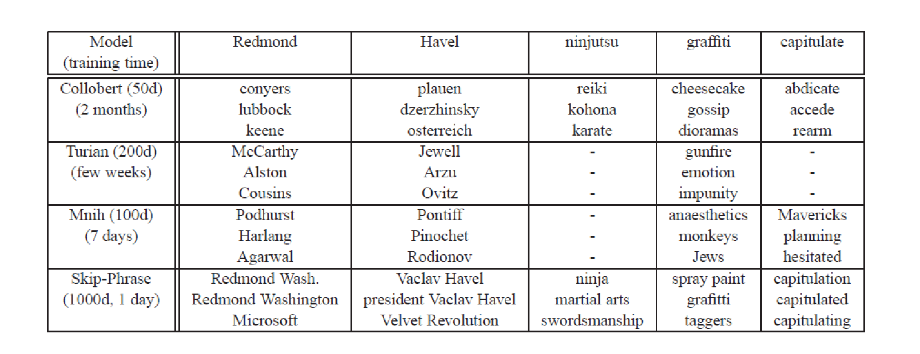
COMPARISONS

Slide 54
For more details on implementation and Learning functions
https://necromuralist.github.io/Neurotic-Networking/posts/nlp/training-the-cbow-model/

Slide 55
PAPERS - REFERENCES including additional reading
1. Y. Bengio, R. Ducharme, P. Vincent. A neural probabilistic language model. Journal of Machine Learning Research, 3:1137-1155, 2003.
F Morin, Y Bengio ; Hierarchical probabilistic neural network language model. - Aistats, 2005
T Mikolov, I Sutskever, K Chen, GS Corrado : Distributed representations of words and phrases and their compositionality, NIPS 2013
Jeffrey Pennington, Richard Socher, Christopher D. Manning: GloVe: Global Vectors for Word RepresentationPennington, Proceedings of the 2014 conference on empirical methods in natural language processing (EMNLP). 2014.
Huang, Eric H., et al. "Improving word representations via global context and multiple word prototypes." Proceedings of the 50th Annual Meeting of the Association for Computational Linguistics: Long Papers-Volume 1. Association for Computational Linguistics, 2012

Slide 56
GLOVE VECTORS
Objective - produce linear directions of meaning with global log-bilinear regression models
Uses weighted least squares model that trains on global word-word co-occurrence counts
Makes efficient use of statistics

Slide 57
CONTEXT - CO-OCCURRENCE MATRIX
X – matrix that stores Word-Word co-occurrence within a pre-defined context
X_{ij} = number of times word j occurs in the context of word i.
Compute probability of word j occurring in the context of word i
P_{ij} = P(j/i) = X_{ij} / X_{i}

Slide 58
HOW MEANING IS EXTRACTED FROM COOCCURRENCE PROBABILITIES
Let i = ice and j = steam be two words for which we want to test closeness of meaning
Relationship of these words can be determined by studying the ratio of their co-occurrence probabilities with various other probe words k
If k = water – then it is related to both I and j equally strongly
If k = solid – then it is related more strongly to ice than steam
If k = gas – then it is related more strongly to steam then ice
If K = fashion – then it is related to neither

Slide 59
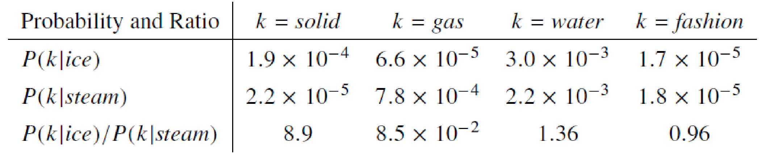
EXAMPLE – VALUES FROM A THERMODYNAMICS CORPUS
Let us look at ratios of co-occurring probabilities

Slide 60
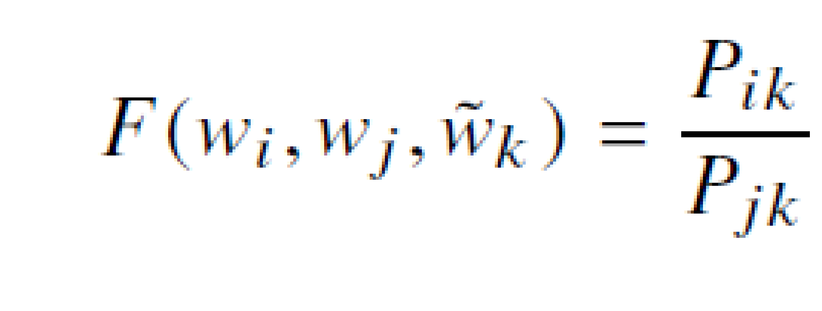
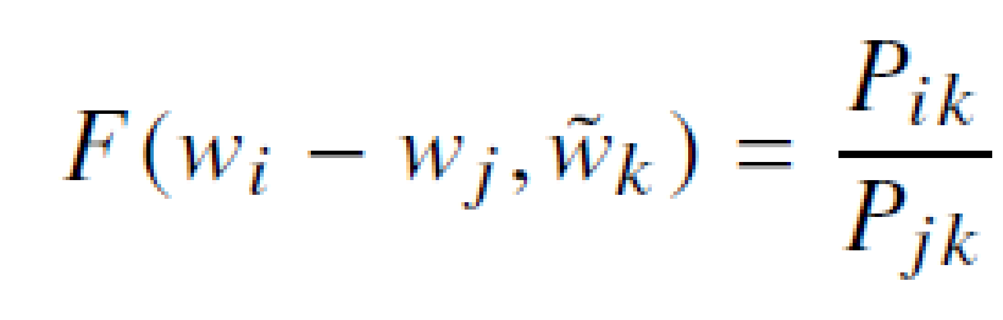
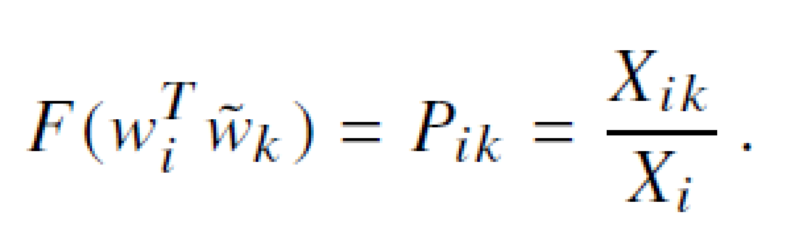
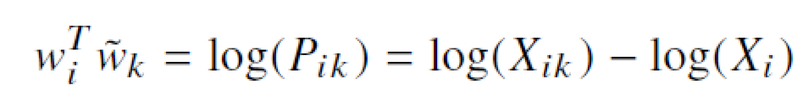
ENCODING LINEARITY OF WORD VECTOR REPRESENTATIONS
A Function that encodes the difference between two words
A Function that encodes the difference between two probe words

Slide 61
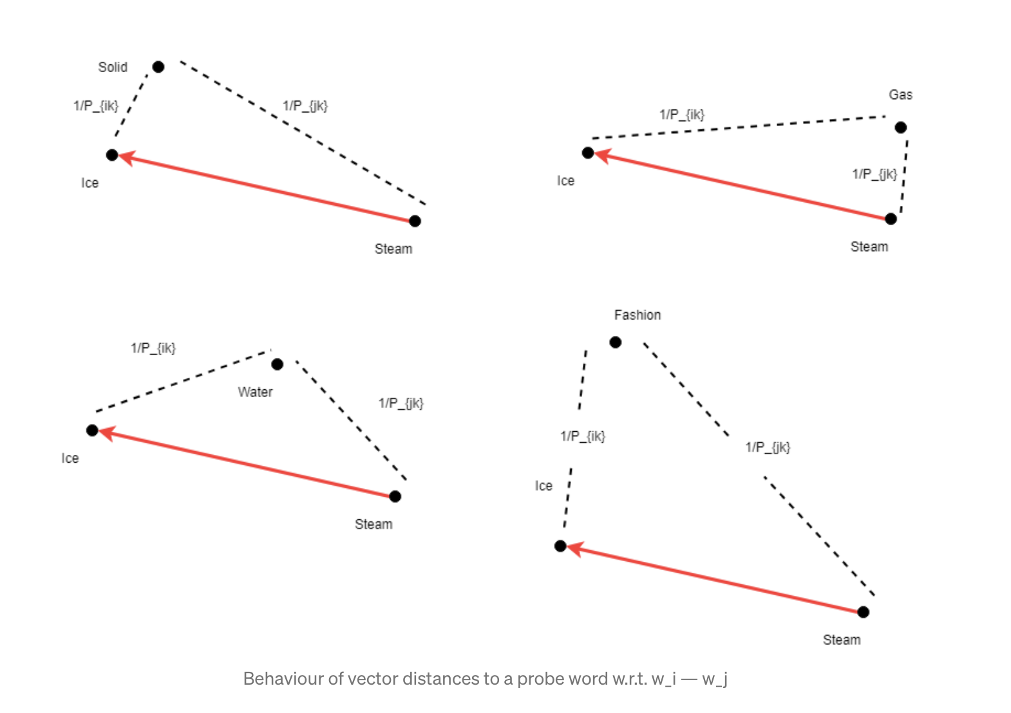
In the Vector space

Slide 62


A LITTLE MATH MANIPULATION

Slide 63



THE MODEL
Not all co-occurrences are frequent – 75 – 95% of co-occurrences are infrequent
A new error function
X_{max} = 100 and α = 0.75

Slide 64


WITH A SOFTMAX
Models probability of word j occurring in context of word j
Minimize

Slide 65


Slide 66


Slide 67

DOES WORD VECTOR TACKLE AMBIGUITY?
Bank
Class
Jaguar
Money
Section
Car
River
Label
cat

Slide 68




GLOBAL AND LOCAL CONTEXT
Given a sequence of words s – which in this case is a sentence s - and a document d in which it occurs
Assign scores to sequences that end with target word as different from those where the last word is not the target word
Earlier model
Addition to new model

Slide 69

COMBINING GLOBAL AND LOCAL CONTEXT

Slide 70
MULTIPLE REPRESENTATION
Use learnt embeddings for single prototype to represent context windows of fixed size
Gather all fixed context windows for a learnt word
Experiment with context of -5 and + 5 words
Each context is represented by a weighted average of all words appearing in the context window
Cluster the resulting vectors using any clustering algorithm
Learn a representation for each context

Slide 71



RESULTS
To decide context

